Slide 1

Algorithms and Data Structures 2 CS 1501
Spring 2022
Sherif Khattab
ksm73@pitt.edu
(Slides are adapted from Dr. Ramirez’s and Dr. Farnan’s CS1501 slides.)

Slide 2
Announcements
Upcoming deadlines:
Homework 9 due on 3/28
Assignment 2 due on 3/28
Lab 9 due on 4/1
Assignment 3 and 4 due on 4/18
Used to be one assignment

Slide 3
Previous lecture …
Repeated Minimum Problem
Priority Queue and heap

Slide 4
CourseMIRROR Reflections (most confusing)
graphic tracing
The PQ sorting got confusing while tracing
The heap sort was most confusing
How to make the heap from the array was a bit confusing
I was confused about when we would use a heap in an array or use it in a BTree structure. Are both done?
Why would you use Prims algorithms versus Kruskals algorithm to find a MST?

Slide 5
CourseMIRROR Reflections (most interesting)
Analysis of different type of tries
Knowing the index of a child/parent of a node with the index formulas
that you can represent a heap with just an array
min heap insertion
Seeing heaps and indexes. Some databases are built over these structures
Heaps! And their find/insert/remove operations
Kruskals seemed more straighforward than Prims
I found it interesting how a HeapSort used the heap properties to sort effectively

Slide 6
Repetitive Minimum Problem
Input:
a (large) dynamic set of data items in the form of
Output:
find a minimum item
You are implementing an algorithm that repeats this problem
examples of such an algorithm?
Prim’s, Huffman tree construction
What we cover today applies to the repetitive maximum problem as well

Slide 7
Let’s create an ADT!
The Priority Queue ADT
Primary operations of the PQ:
Insert
Find item with highest priority
e.g., findMin() or findMax()
Remove an item with highest priority
e.g., removeMin() or removeMax()
Update an item

Slide 8
Indirection
Maintain a second data structure that maps item IDs to each item’s current position in the heap
This creates an indexable PQ

Slide 9
Indirection example setup
Let's say I'm shopping for a new video card and want to build a heap to help me keep track of the lowest price available from different stores.
Keep objects of the following type in the heap:
class CardPrice implements Comparable<CardPrice>{
public String store;
public double price;
public CardPrice(String s, double p) { … }
public int compareTo(CardPrice o) {
if (price < o.price) { return -1; }
else if (price > o.price) { return 1; }
else { return 0; }
}
}

Slide 10
Indirection example
n = new CardPrice("NE", 333.98);
a = new CardPrice("AMZN", 339.99);
x = new CardPrice("NCIX", 338.00);
b = new CardPrice("BB", 349.99);
Indirection
"NE":0
"NE":2
"AMZN":1
"AMZN":0
"AMZN":1
Update price for NE: 340.00
"NCIX":0
"NCIX":2
"NCIX":3
"NCIX":1
"BB":0
"BB":3
"BB":1
Update price for NCIX: 345.00
Update price for BB: 200.00
a
b
b
x
n
a
x
x
a
x
n
b
Notes:
How are our runtimes affected?
space utilization?
how should we implement the indirection?
what are the tradeoffs?

Slide 11
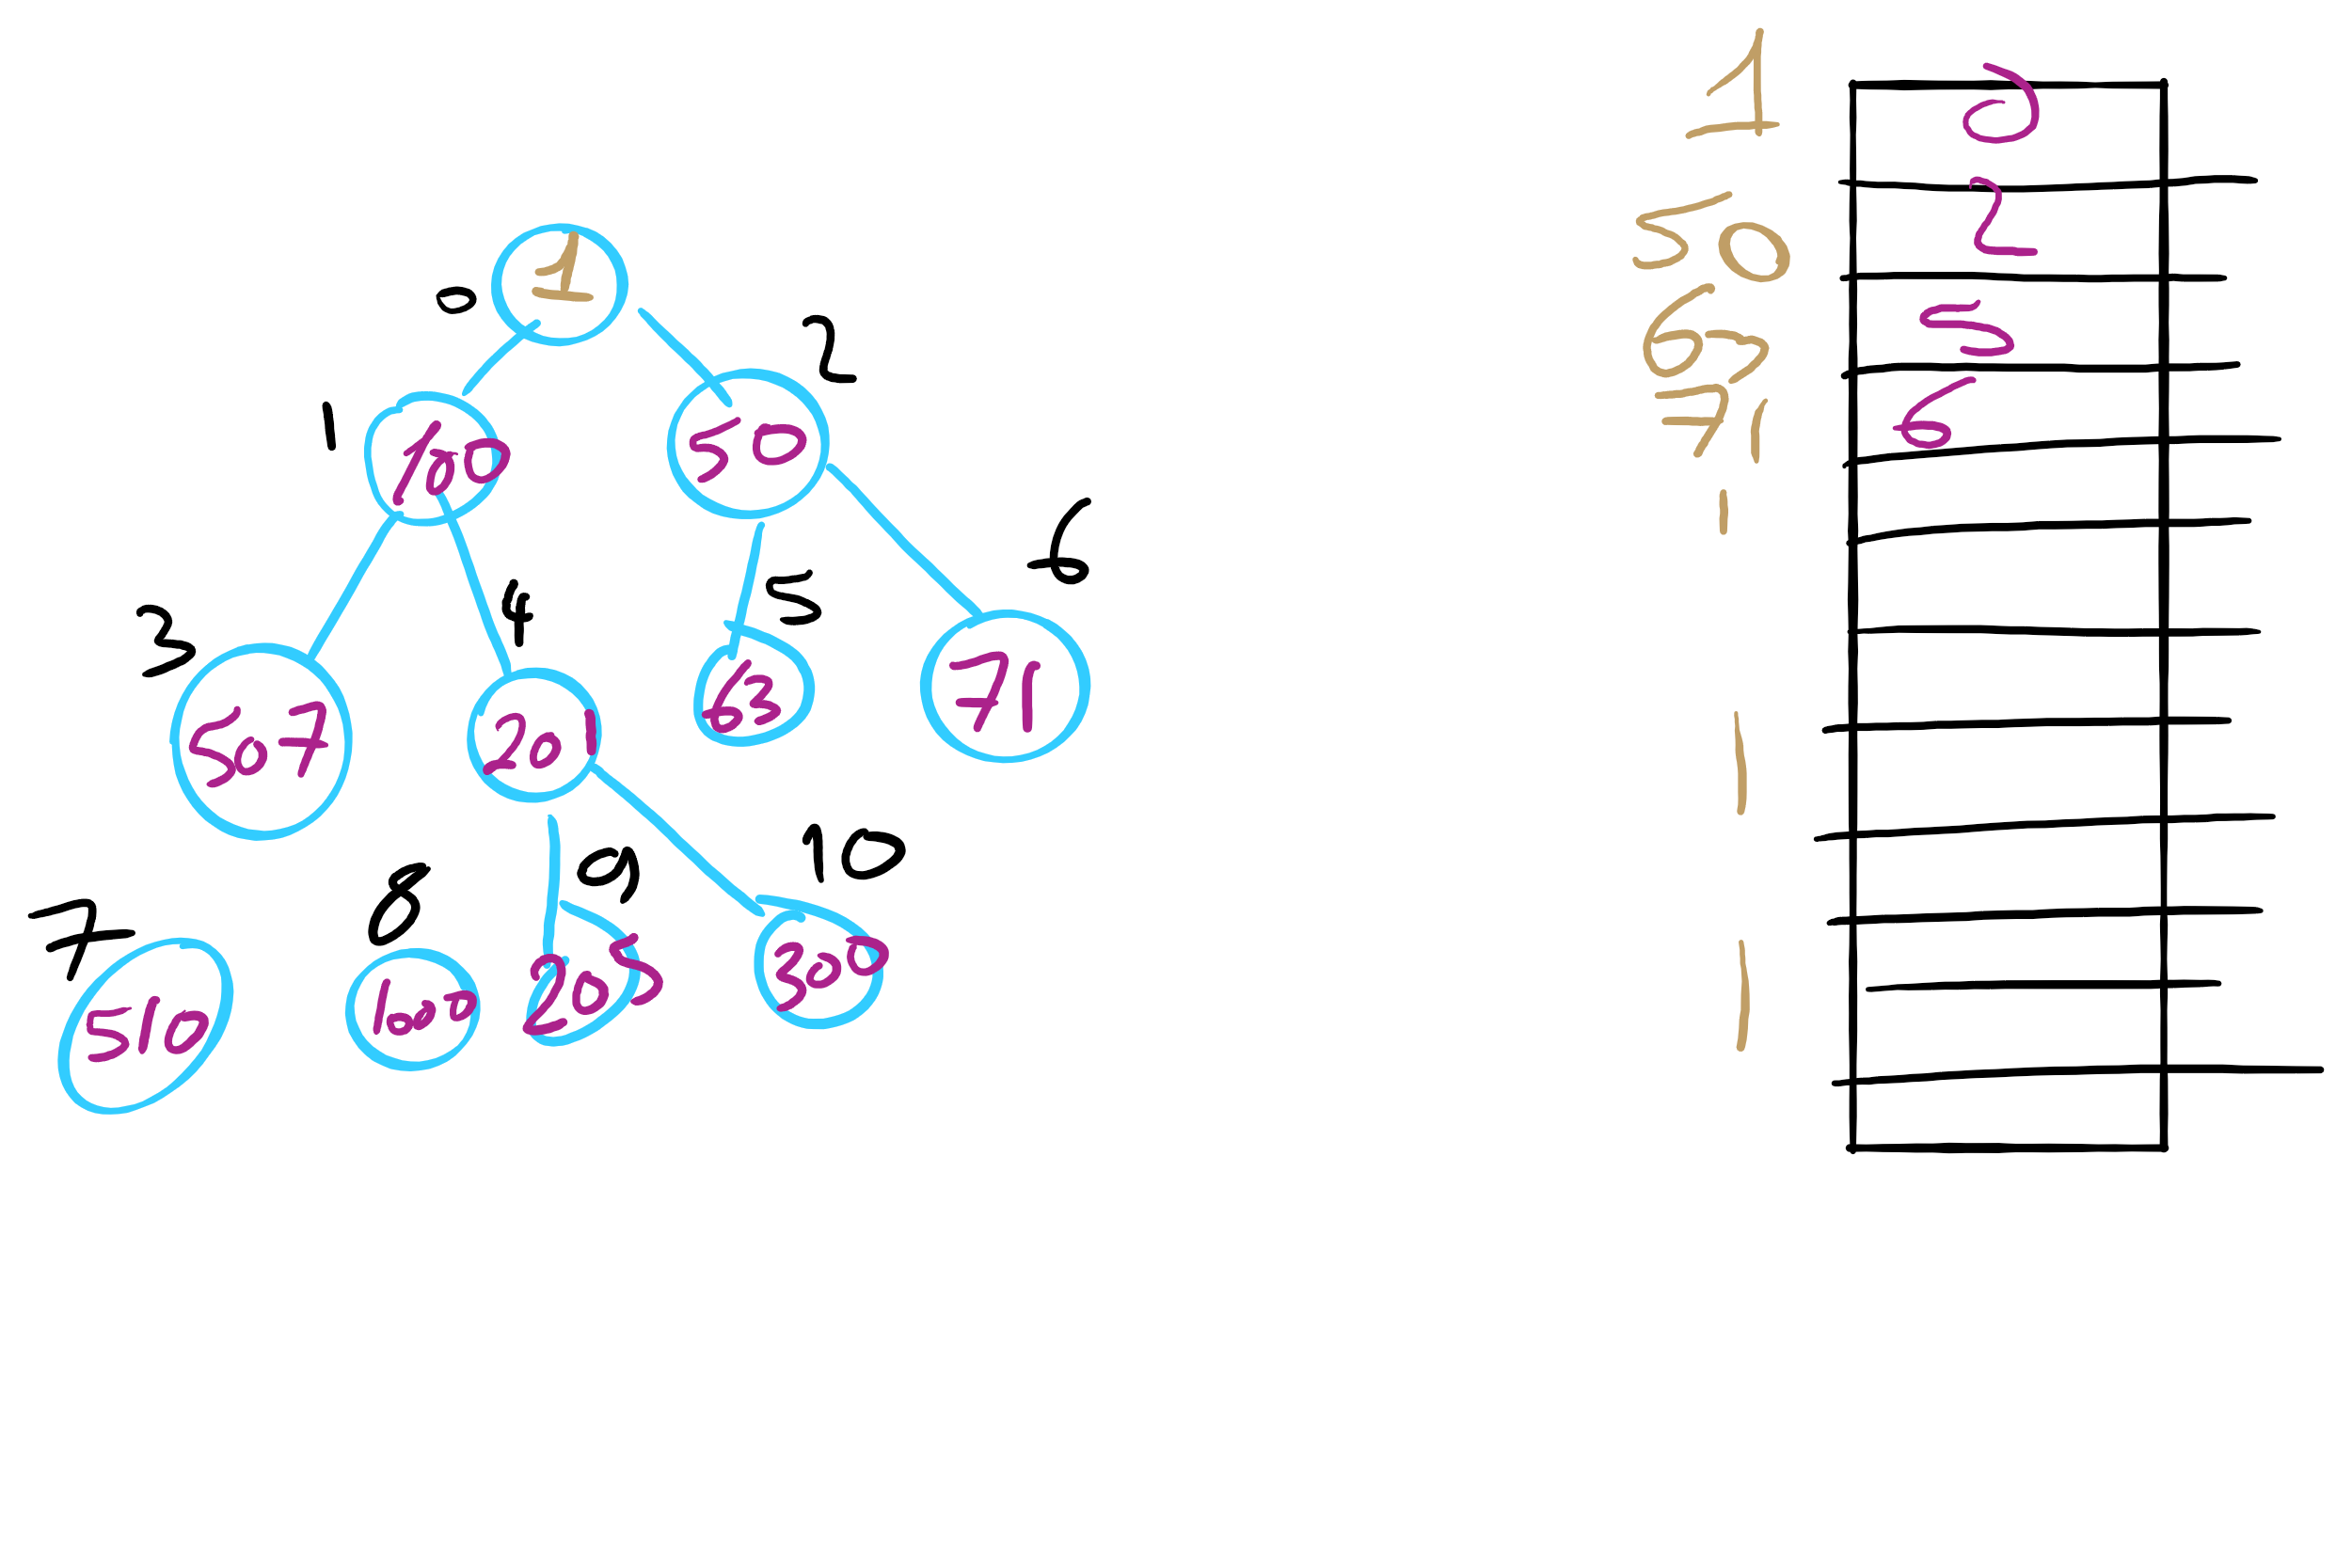
Indexable PQ Example

Slide 12
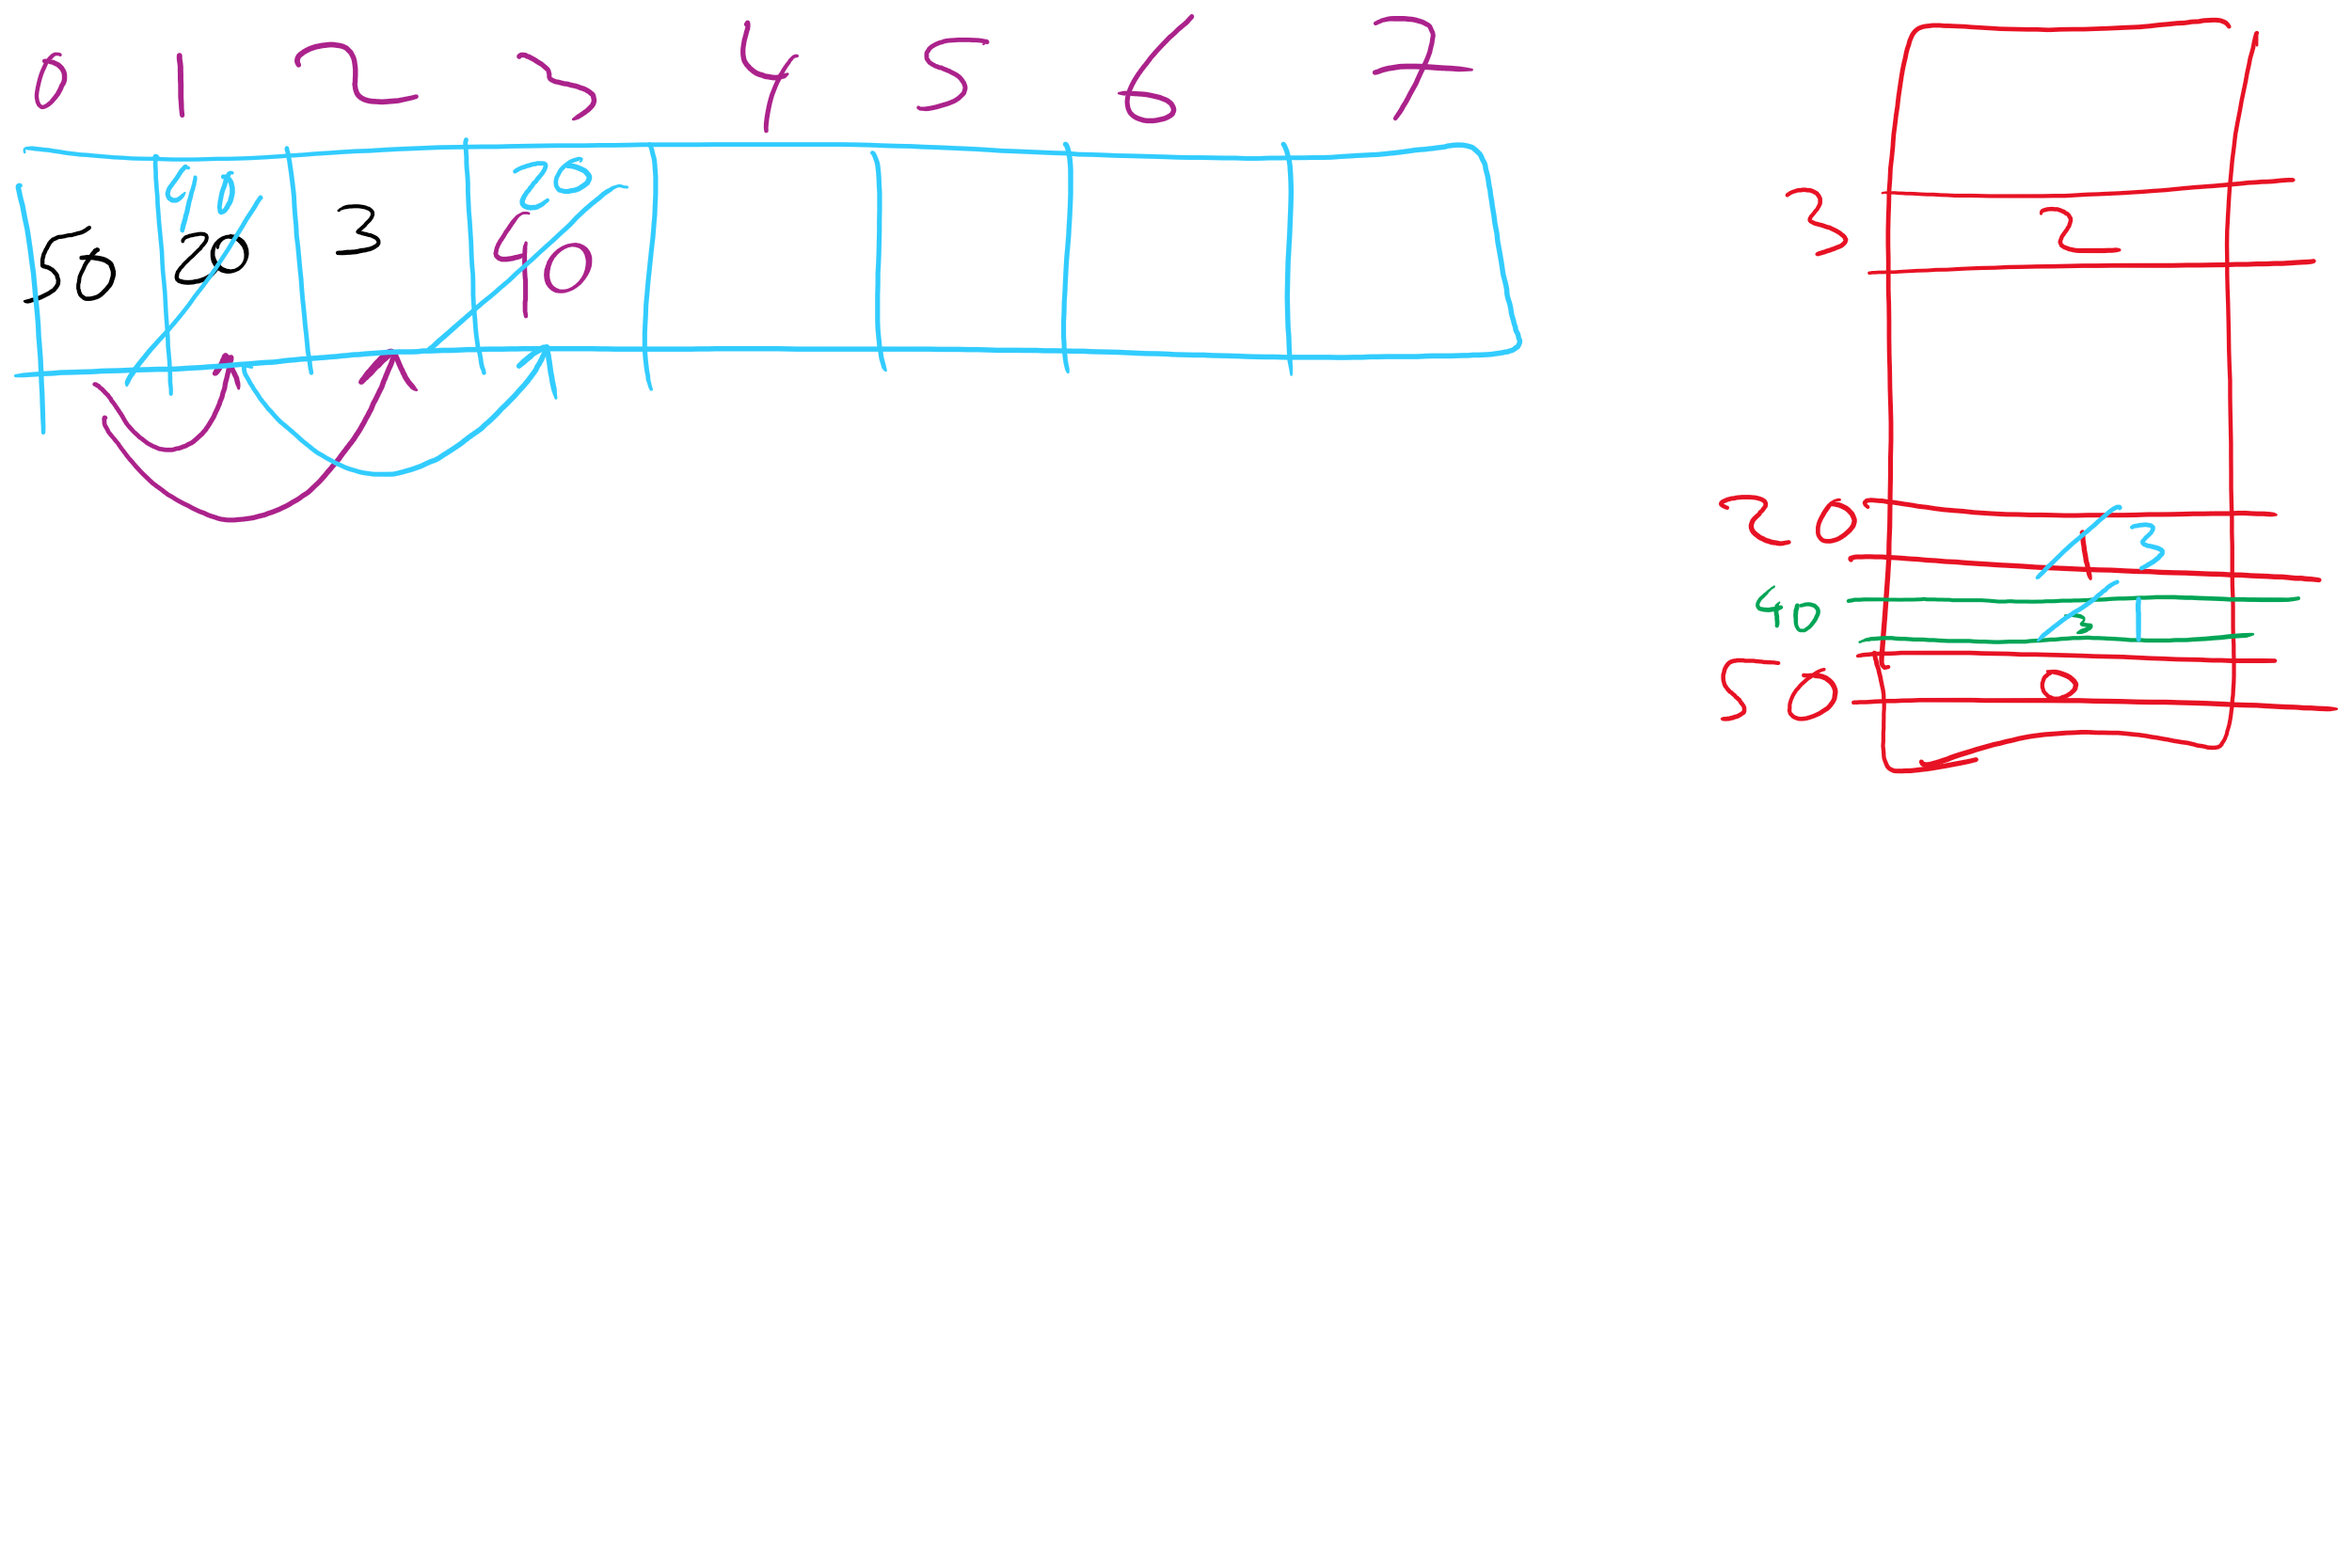
Indexable PQ Example

Slide 13
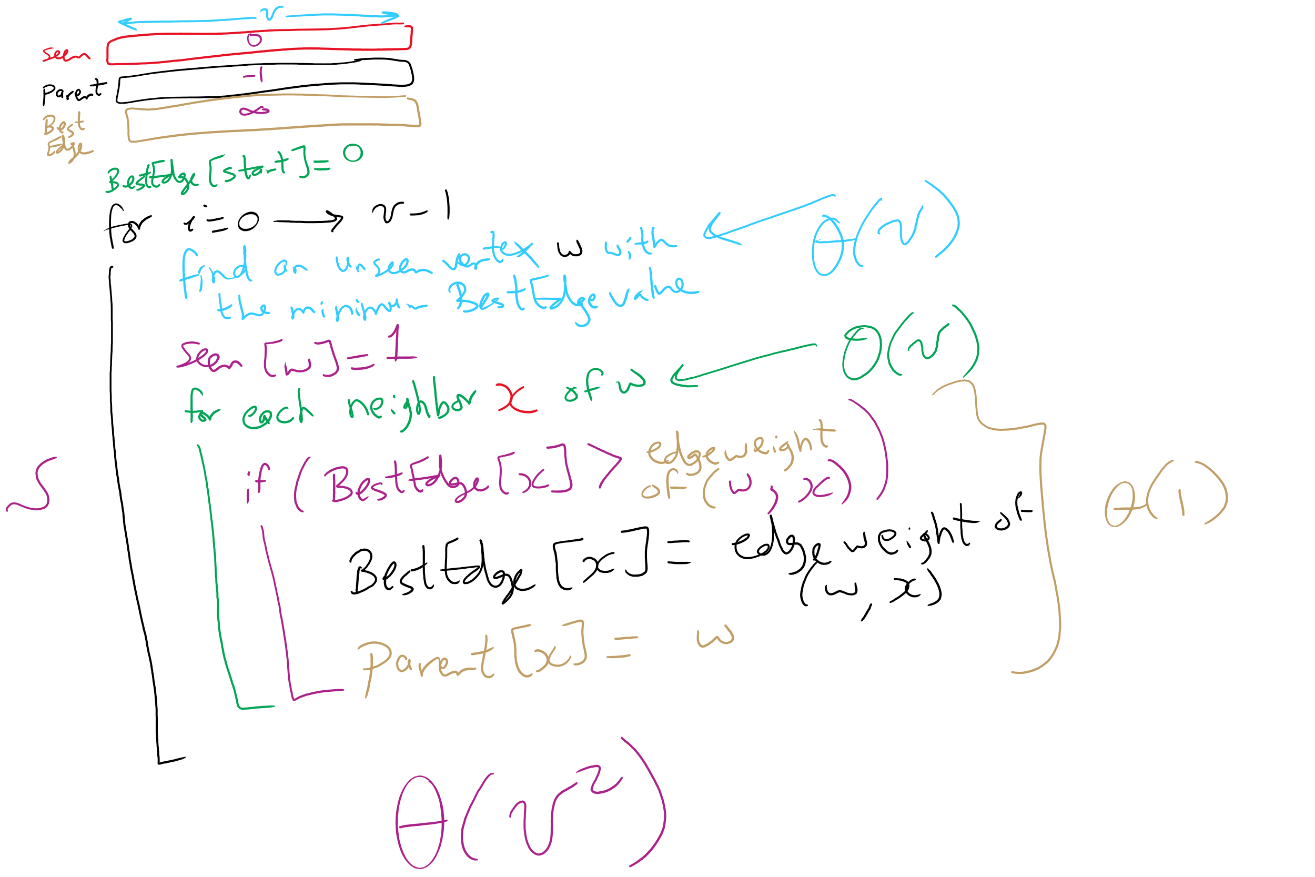
Prim’s MST Algorithm

Slide 14
OK, so what's our runtime?
For every vertex we add to T, we’ll need to check all of its neighbors to check for edges to add to T next
Let's assume we use an adjacency matrix:
Takes Θ(v) to check the neighbors of a given vertex
Time to update parent/best edge arrays?
Time to pick next vertex?
What about with an adjacency list?
Notes:
v vertices will be added to T, so we do the following v times:
Search through the neighbors of the next vertex to adjust the parent and best edge arrays as needed
Constant time to update parent/best edge arrays
Neighbor enumeration:
Matrix:
Θ(v)
List:
Θ(degree)
Search through the best_edge array to find the next addition to T
Θ(v)
So, matrix:
We do v * 2 * Θ(v) work
Θ(v²)
List:
We do v * (Θ(v) + degree) work
Θ(v²)

Slide 15
Prim’s MST: What about a faster way to pick the best edge?
Sounds like a job for a priority queue!
Priority queues can remove the min value stored in them in Θ(lg n)
Also Θ(lg n) to add to the priority queue
What does our algorithm look like now?
Visit a vertex
Add edges coming out of it to a PQ
While there are unvisited vertices, pop from the PQ for the next vertex to visit and repeat
Notes:
Change in runtime?
θ(d) work to list neighbors,
in the worst case, v == d, so no asymptotic improvement, but a practical one.
Less memory required to store the graph
but doesn't affect memory required to run the algorithm, still need 2 * θ (v) to store parent and best edge arrays
this version of Prim's just adds all edges to a PQ
before we constrained ourselves to only maintain v best edges to look at
how do we get the best of both?
indexable pq

Slide 16
Prim's with a priority queue
0
0
PQ:
6
5
1
1
3
1: (0, 2)
1
3
2: (5, 3)
5
5
3: (1, 4)
2
2
3
2
4: (2, 5)
6
4
5: (2, 3)
5: (0, 3)
4
5
4
5
6
5: (2, 1)
6: (0, 1)
6: (2, 4)
6: (5, 4)

Slide 17
Runtime using a priority queue
Have to insert all e edges into the priority queue
In the worst case, we’ll also have to remove all e edges
So we have:
e * Θ(lg e) + e * Θ(lg e)
= Θ(2 * e lg e)
= Θ(e lg e)
This algorithm is known as lazy Prim’s
Notes:
discuss why this isn't lg v for PQ operations, lead to how we constrained number of best edges before to be v, lead to indexable PQ discussion

Slide 18
Do we really need to maintain e items in the PQ?
I suppose we could not be so lazy
Just like with the adjacency matrix implementation, we only need the best edge for each vertex
PQ will need to be indexable
This is the idea of eager Prim’s
Runtime is Θ(e lg v)

Slide 19
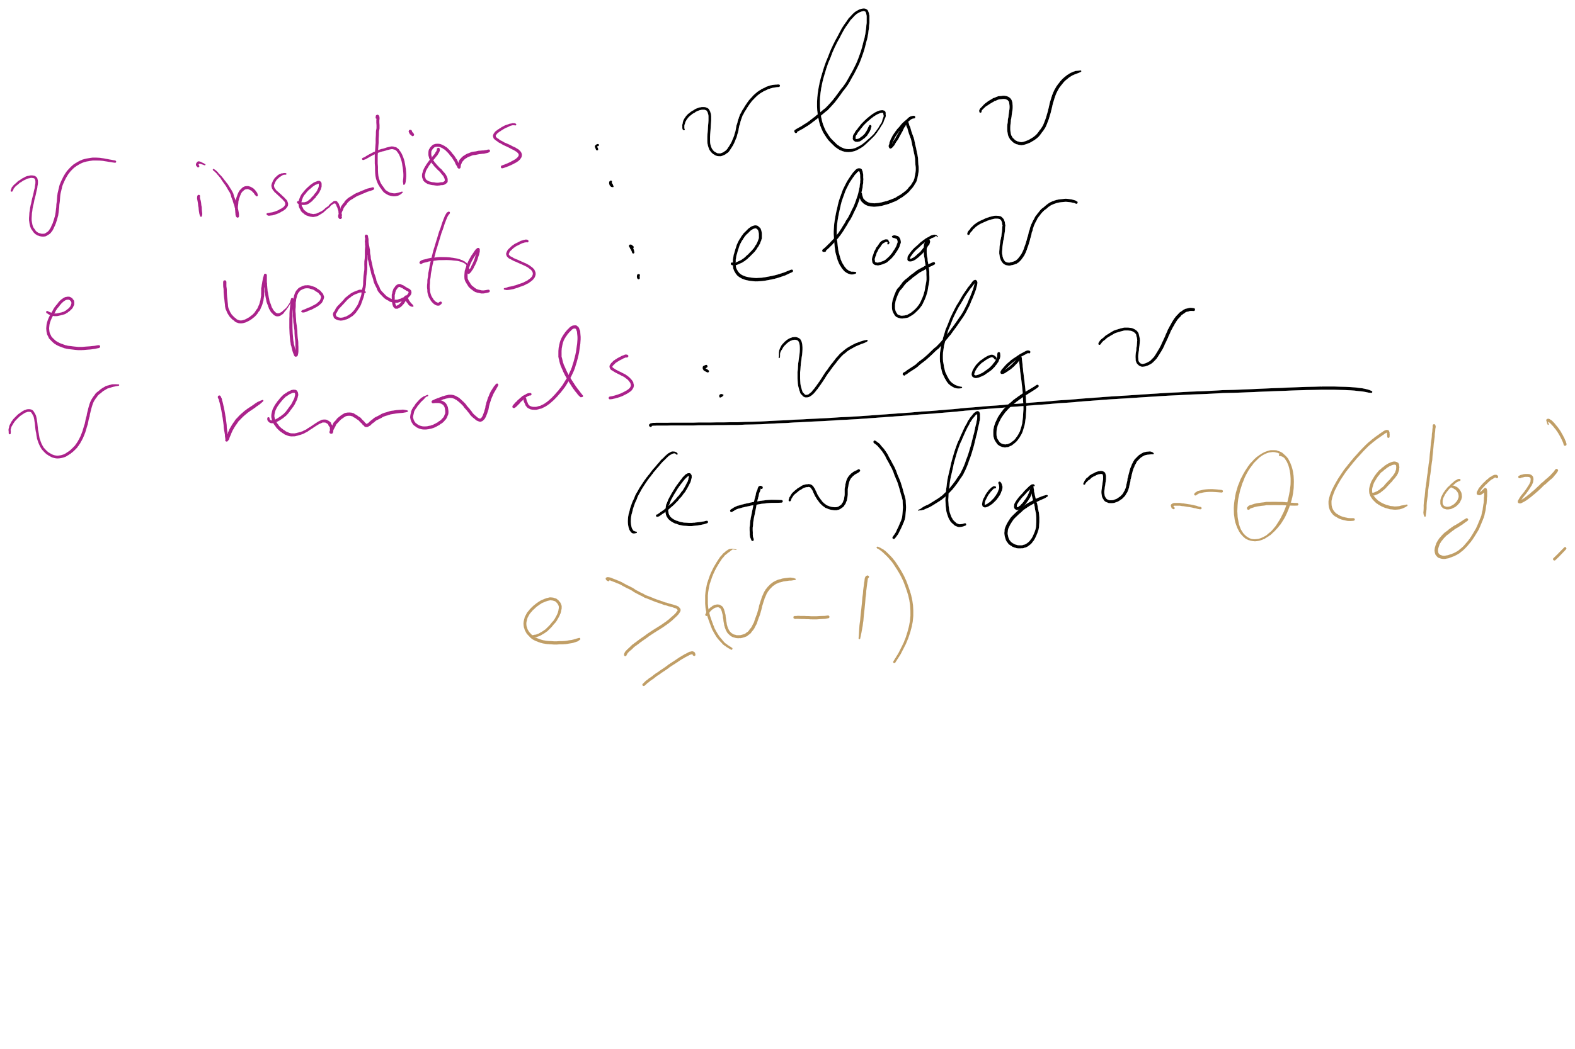
Eager Prim’s Runtime

Slide 20
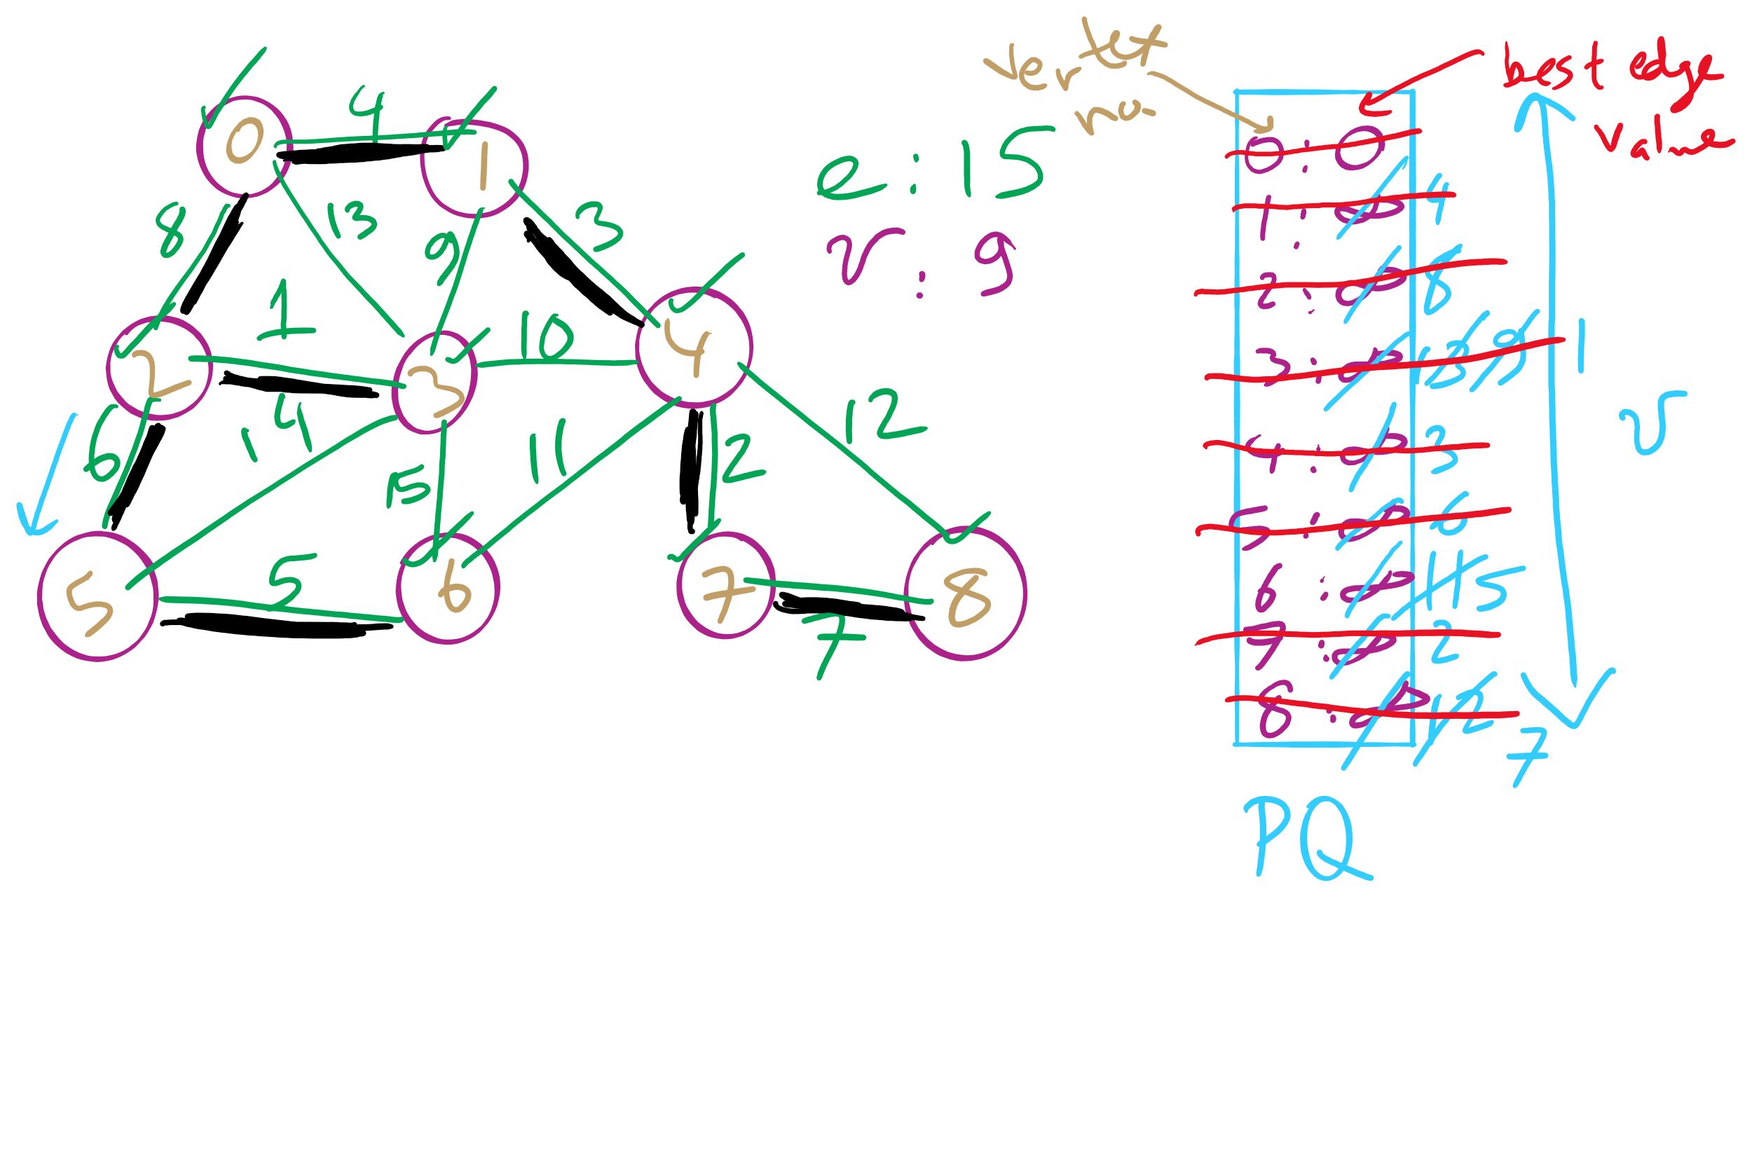
Eager Prim’s Example 1

Slide 21
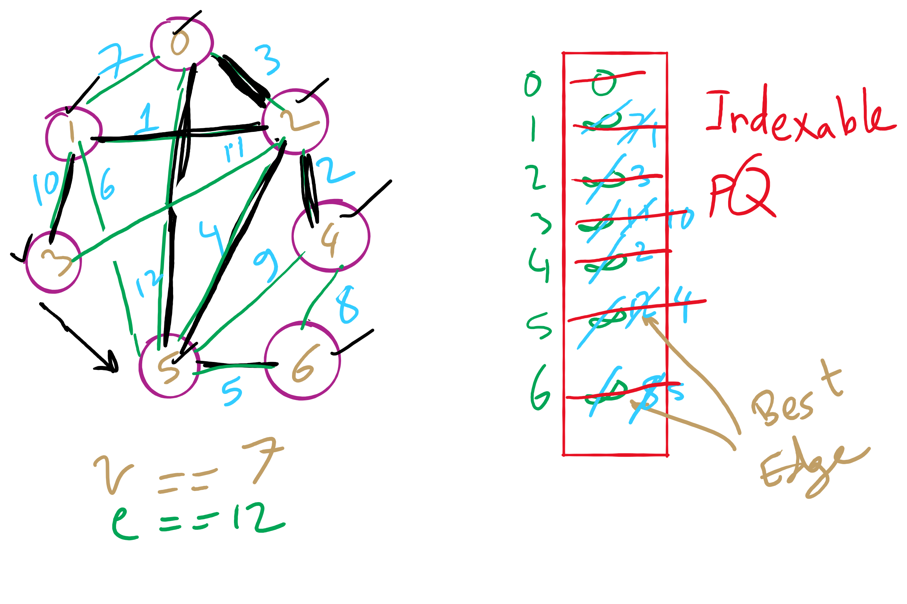
Eager Prim’s Example 2

Slide 22
Comparison of Prim’s implementations
Parent/Best Edge array Prim’s
Runtime: Θ(v²)
Space: Θ(v)
Lazy Prim’s
Runtime: Θ(e lg e)
Space: Θ(e)
Requires a PQ
Eager Prim’s
Runtime: Θ(e lg v)
Space: Θ(v)
Requires an indexable PQ
How do these compare?
Notes:
note that space requirements by these algorithms is space overhead on top of the input (how we represent the graph)

Slide 23
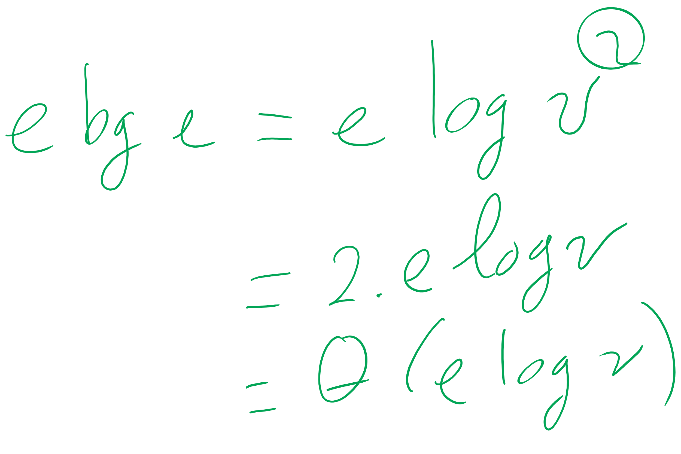
Eager vs. Lazy Prim’s

Slide 24
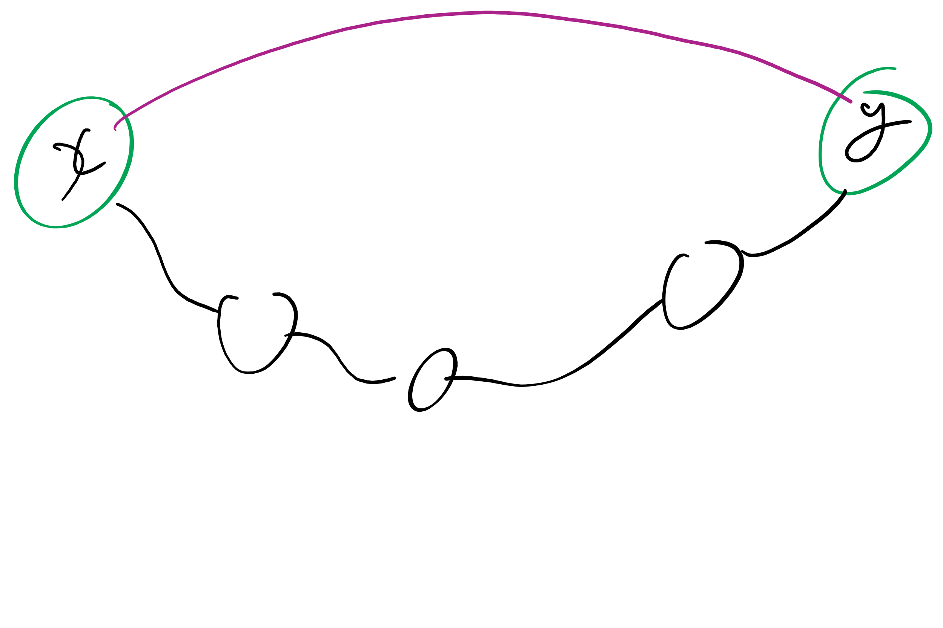
Problem of the Day: Dynamic connectivity problem
Input:
A set of items initially in separate groups and
a sequence of merge/union operations, each operation mering two items
Output:
At any point of time, we can be asked if two items are in the same group
Initially, the answer will be NO for any two items because they start in separate groups
For a given graph G, can we determine whether or not two vertices are connected in G?
Can also be viewed as checking subset membership
Important for many practical applications
Notes:
after describing the problem (bullet 1), ask for a solution
Work towards getting BFS approach
Runtime?
θ(e) using adj list
How can we do better? UF

Slide 25
Let’s build an ADT
Union/Find ADT (aka Disjoint Sets ADT)
Has two operations
Union(x, y)
Merge items x and y into the same group
Find(x)
Return the group number of x

Slide 26
A simple approach
Have an id array simply store the component id for each item in the union/find structure
How do we determine if two vertices are connected?
How do we establish the connected components?
Add graph edges one at a time to UF data structure using union operations
Notes:
Ask for connected component def

Slide 27
Example
U(2, 0)
1
4
U(7, 4)
U(2, 1)
0
2
5
7
U(2, 3)
U(5, 4)
U(5, 7)
3
6
U(3, 6)
0
1
2
3
4
5
6
7
ID:
0
6
3
1
1
6
3
2
0
6
3
1
3
6
4
5
4
6
7
4
Notes:
mention how this can be view as subset membership

Slide 28
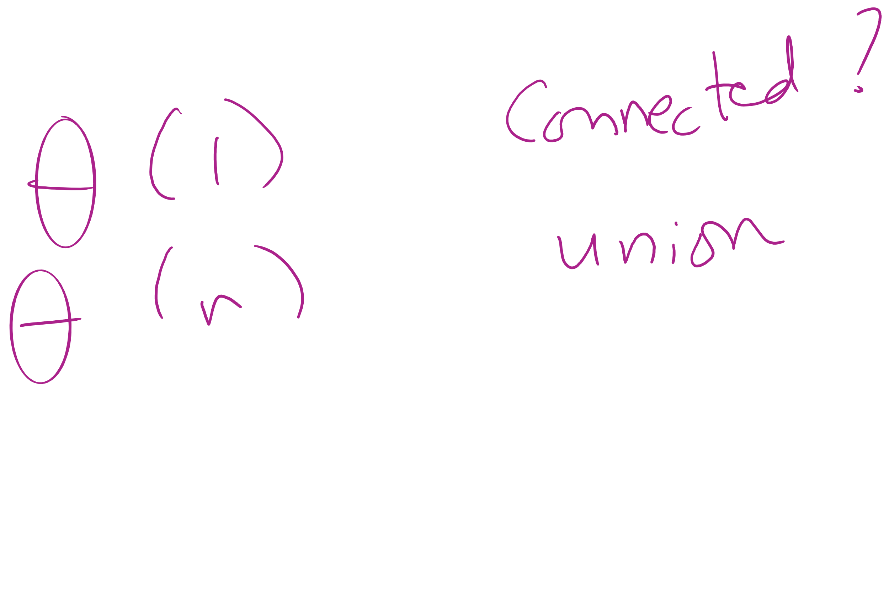
Analysis of our simple approach
Runtime?
To find if two vertices are connected?
For a union operation?
Notes:
"fast find" approach
find:
Θ(1)
union:
Θ(n)

Slide 29
Union Find API
Initialize with n items numbered 0 to n-1
UF (int n)
void union(int p, int q)
int find (int p)
boolean connected (int p, int q)
int count()
Connect p with q
Return id of the connected component that p is in
True if p and q are connected
Number of connected components

Slide 30
Covering the basics
public int count() {
return count;
}
public boolean connected(int p, int q) {
return find(p) == find(q);
}

Slide 31
Implementing the Fast-Find approach
public UF(int n) {
count = n;
id = new int[n];
for (int i = 0; i < n; i++) { id[i] = i; }
}
public int find(int p) { return id[p]; }
public void union(int p, int q) {
int pID = find(p), qID = find(q);
if (pID == qID) return;
for(int i = 0; i < id.length; i++)
if (id[i] == pID) id[i] = qID;
count--;
}

Slide 32
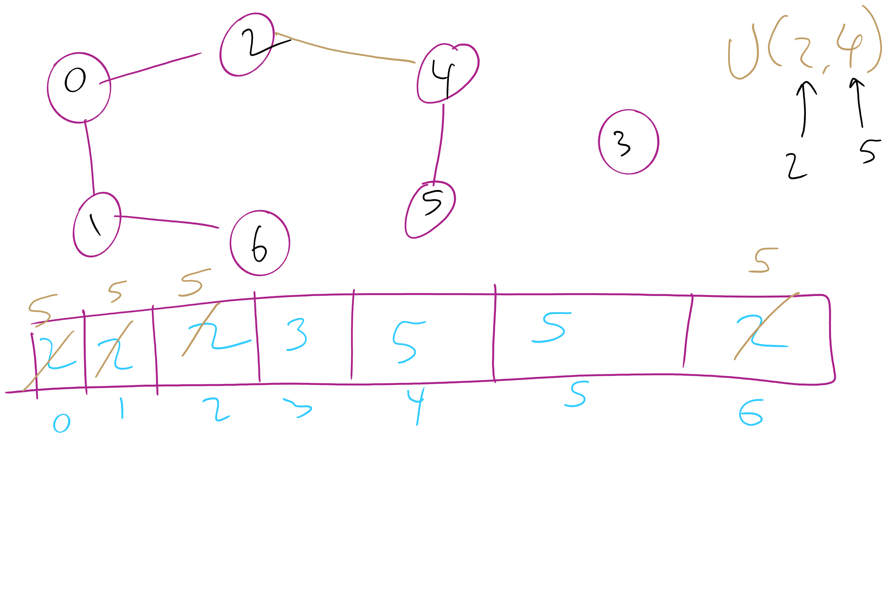
Union-Find Example 1

Slide 33
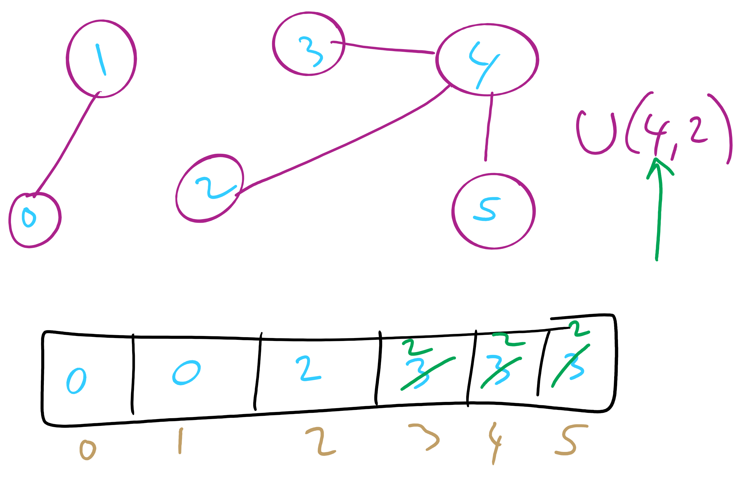
Union-Find Example 2

Slide 34
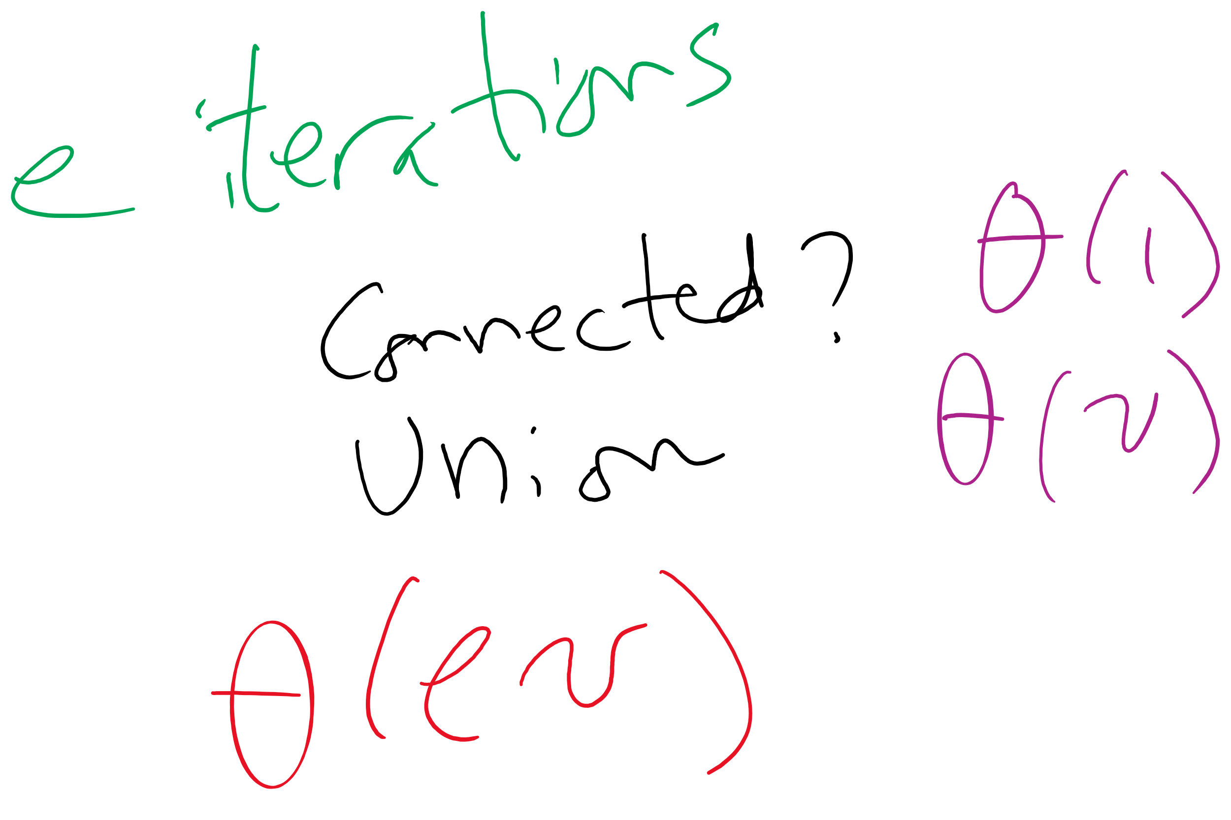
Kruskal’s algorithm Runtime: Take 2
With this knowledge of union/find, how, exactly can it be used as a part of Kruskal’s algorithm?
What is the runtime of Kruskal’s algorithm?
Notes:
Fast-Find's θ(v) union will lead to a θ(v²) runtime for Kruskal's
Each time an edge is added to the MST, need to union, hence v θ(v) union operations
These v union operations dominate runtime

Slide 35
Can we improve on union()’s runtime?
What if we store our connected components as a forest of trees?
Each tree representing a different connected component
Every time a new connection is made, we simply make one tree the child of another

Slide 36
Tree example
1
4
3
0
2
5
7
1
3
6
2
7
0
1
2
3
4
5
6
7

Slide 37
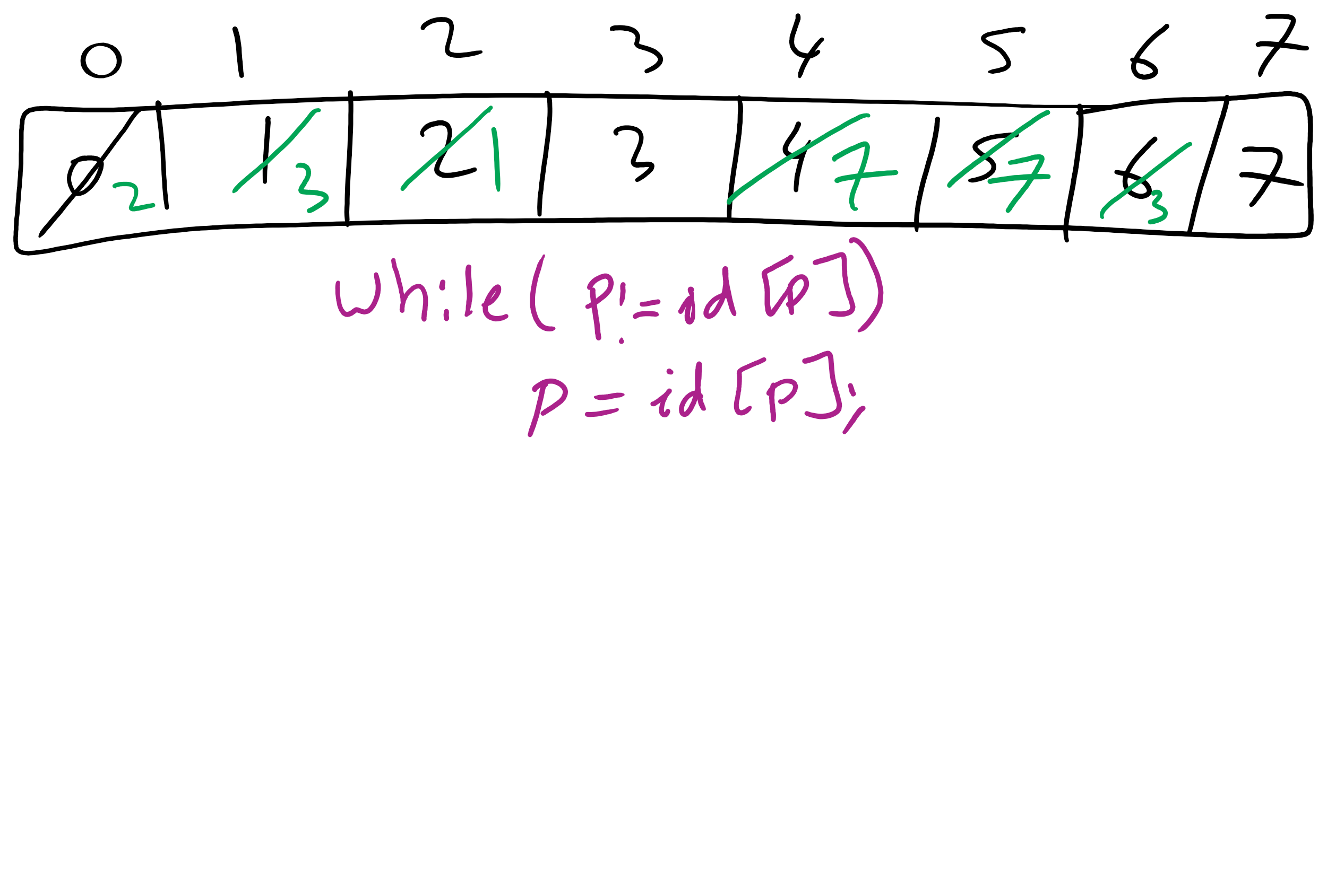
Forest of Trees Implementation
1
4
3
0
2
5
7
1
3
6
2
7
0
1
2
3
4
5
6
7

Slide 38
Implementation using the same id array
public int find(int p) {
while (p != id[p]) p = id[p];
return p;
}
public void union(int p, int q) {
int i = find(p);
int j = find(q);
if (i == j) return;
id[i] = j;
count--;
}

Slide 39
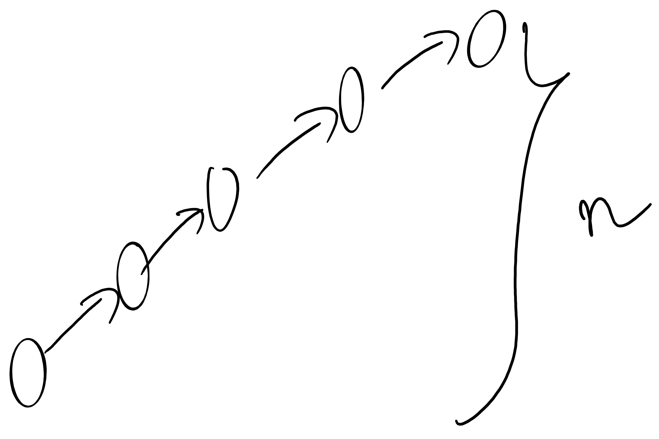
Forest of trees implementation analysis
Runtime?
find():
Bound by the height of the tree
union():
Bound by the height of the tree
What is the max height of the tree?
Can we modify our approach to cap its max height?

Slide 40
Weighted tree example
1
4
0
2
5
7
3
6
2
7
0
1
2
3
4
5
6
7

Slide 41
Weighted trees
public UF(int n) {
count = n;
id = new int[n];
sz = new int[n];
for (int i = 0; i < n; i++) { id[i] = i; sz[i] = 1; }
}
public void union(int p, int q) {
int i = find(p), j = find(q);
if (i == j) return;
if (sz[i] < sz[j]) { id[i] = j; sz[j] += sz[i]; }
else { id[j] = i; sz[i] += sz[j]; }
count--;
}

Slide 42
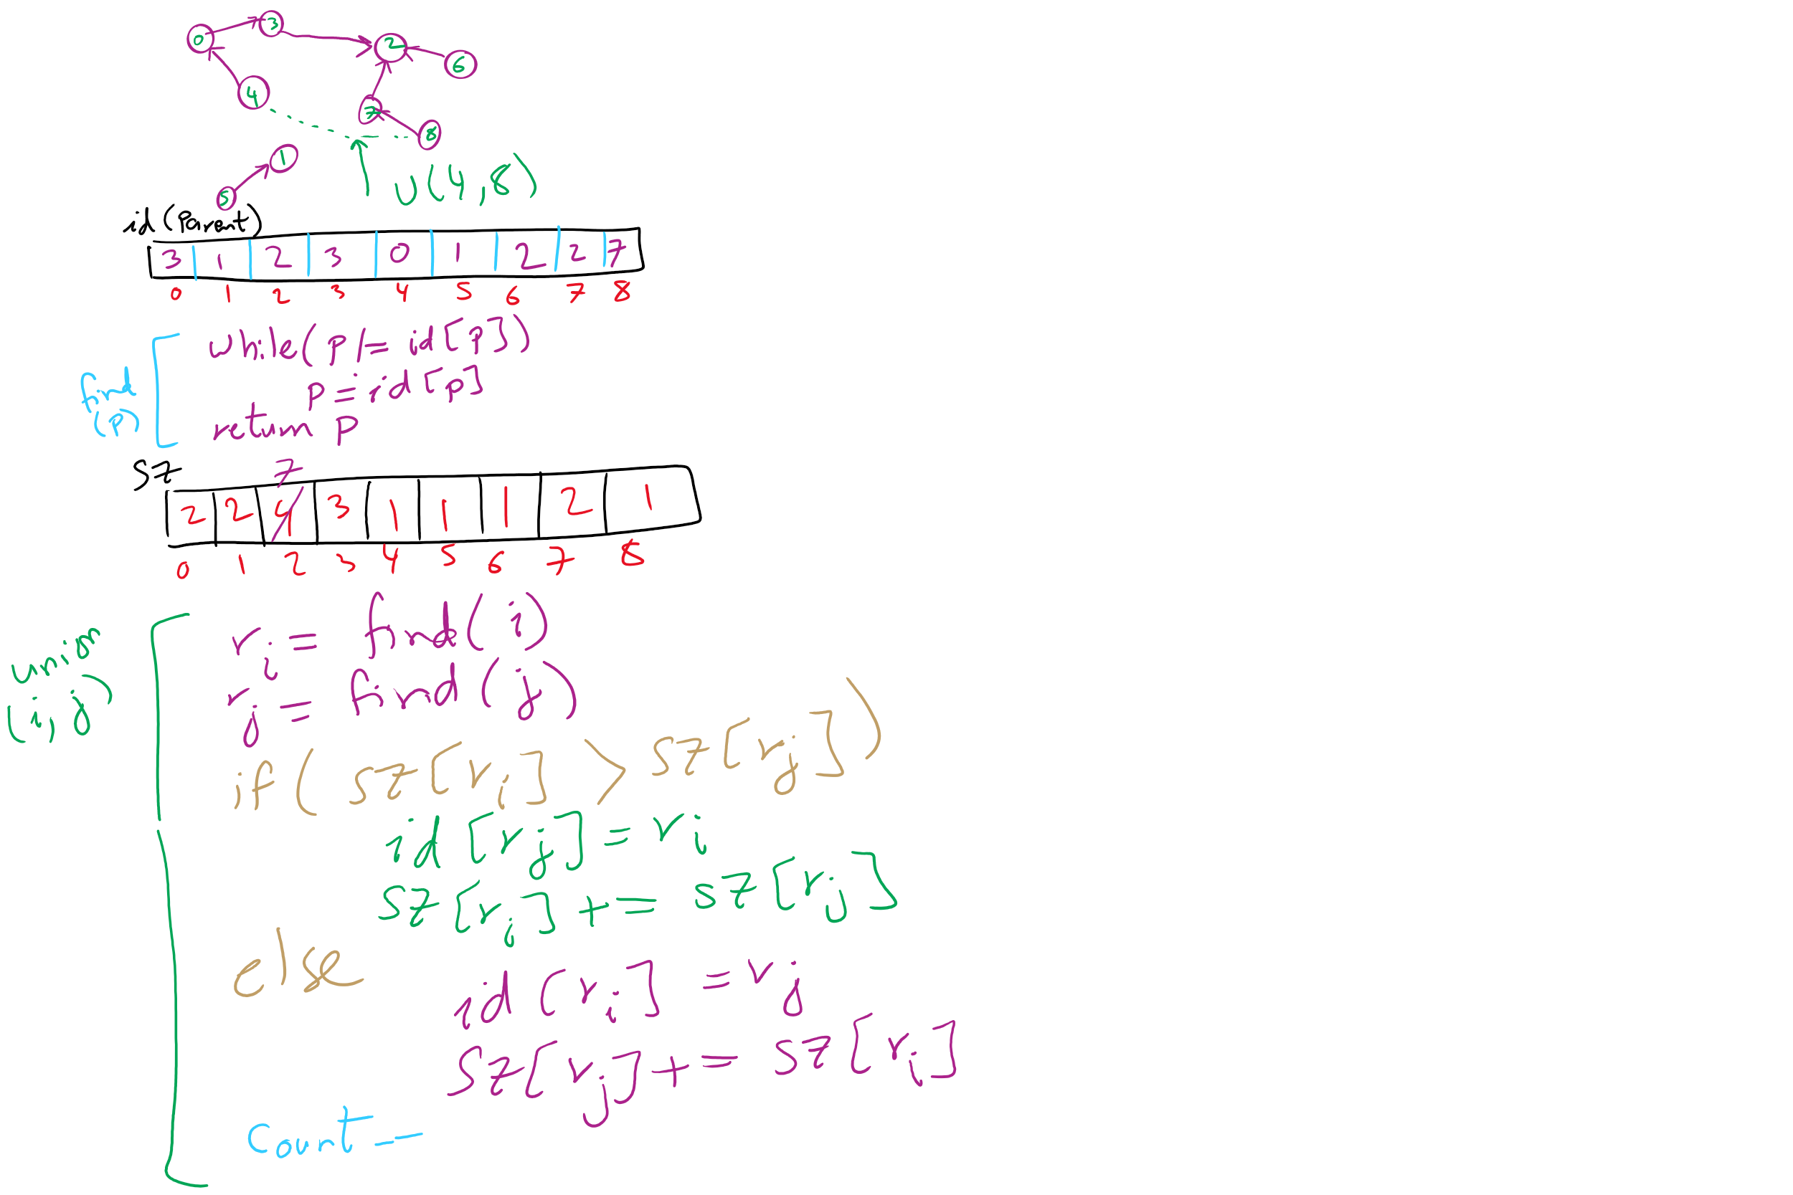
Weighted Trees Union-Find Example

Slide 43
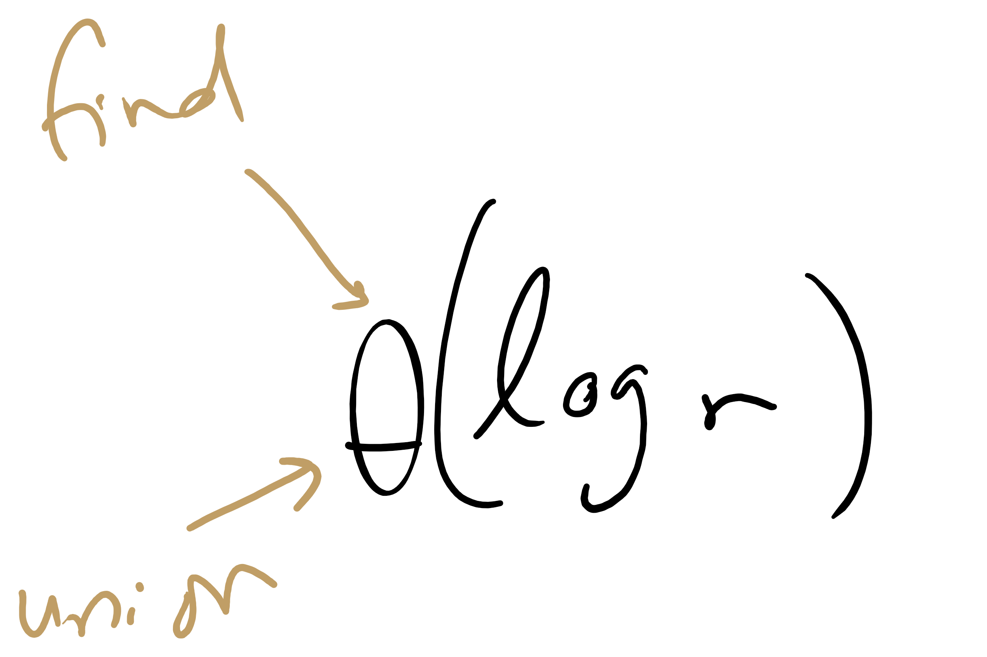
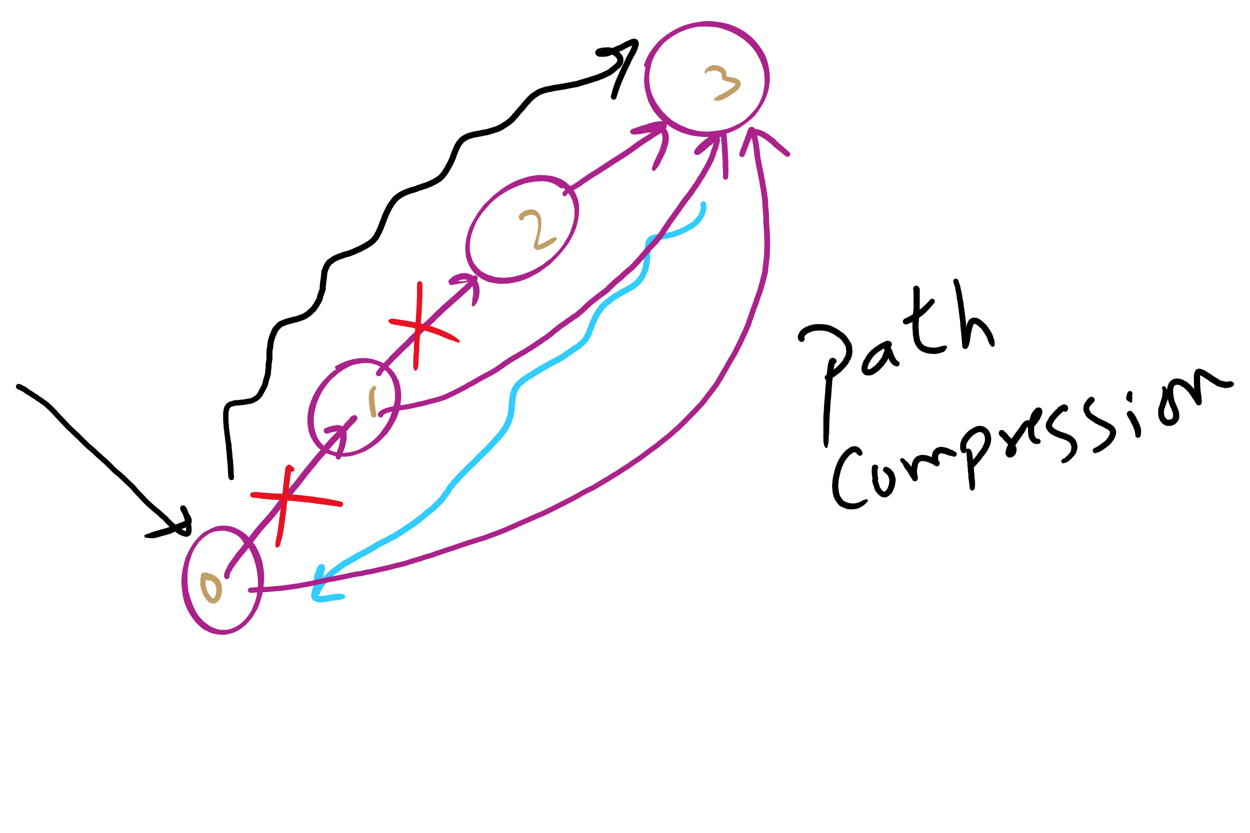
Weighted tree approach analysis
Runtime?
find()?
union()?
Can we do any better?
Notes:
Both find and union:
Θ(log v)
Trees were so flat in this example, why log v?
Because we didn't build up independent connected components
Can do better with path compression, where another loop is added to find() to link everything we come across directly back to the root
this is optimal, but not quite constant time
direct students to exercised in section 1.5 of the text

Slide 44
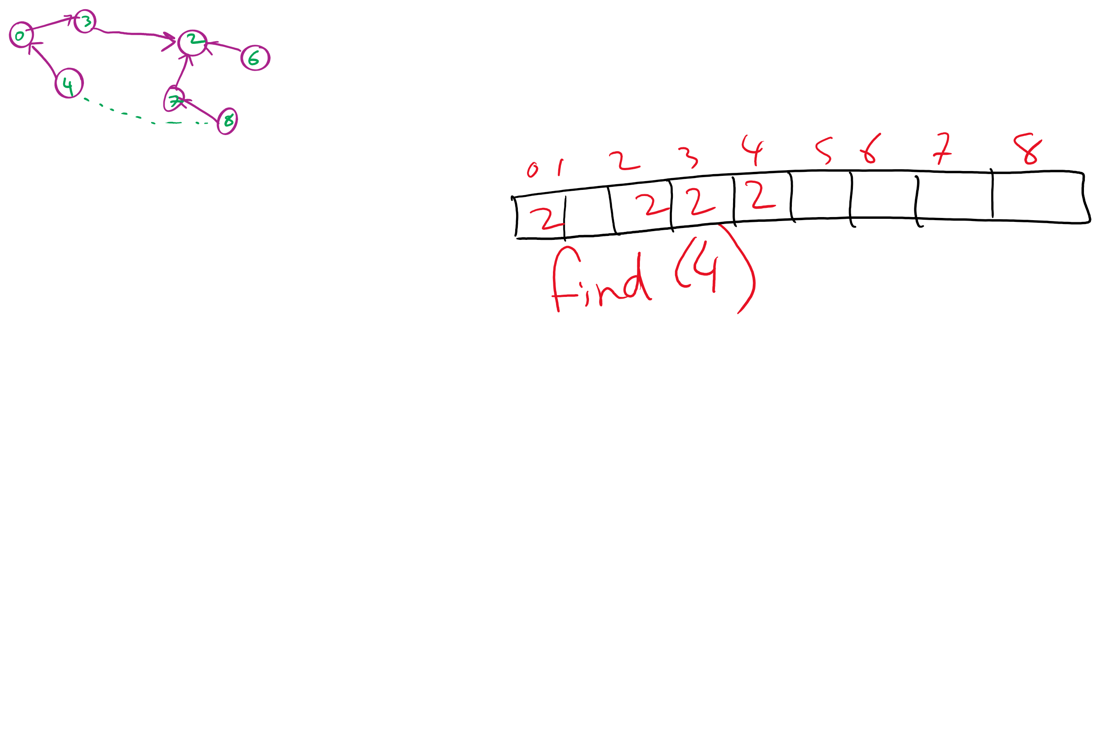
Path Compression Example

Slide 45
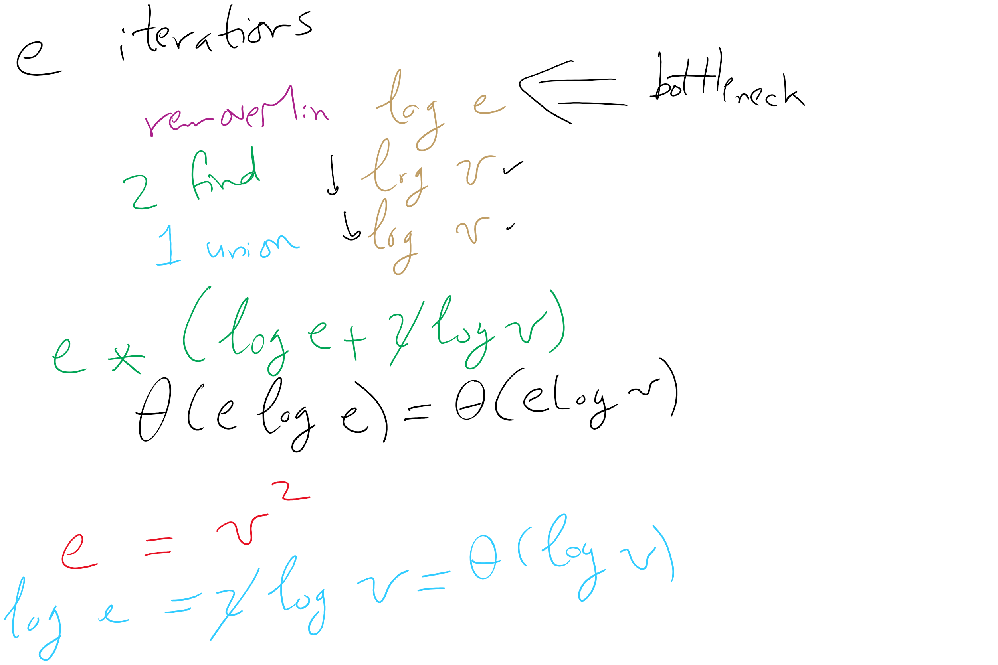
Kruskal’s algorithm, once again
What is the runtime of Kruskal’s algorithm??

Slide 46
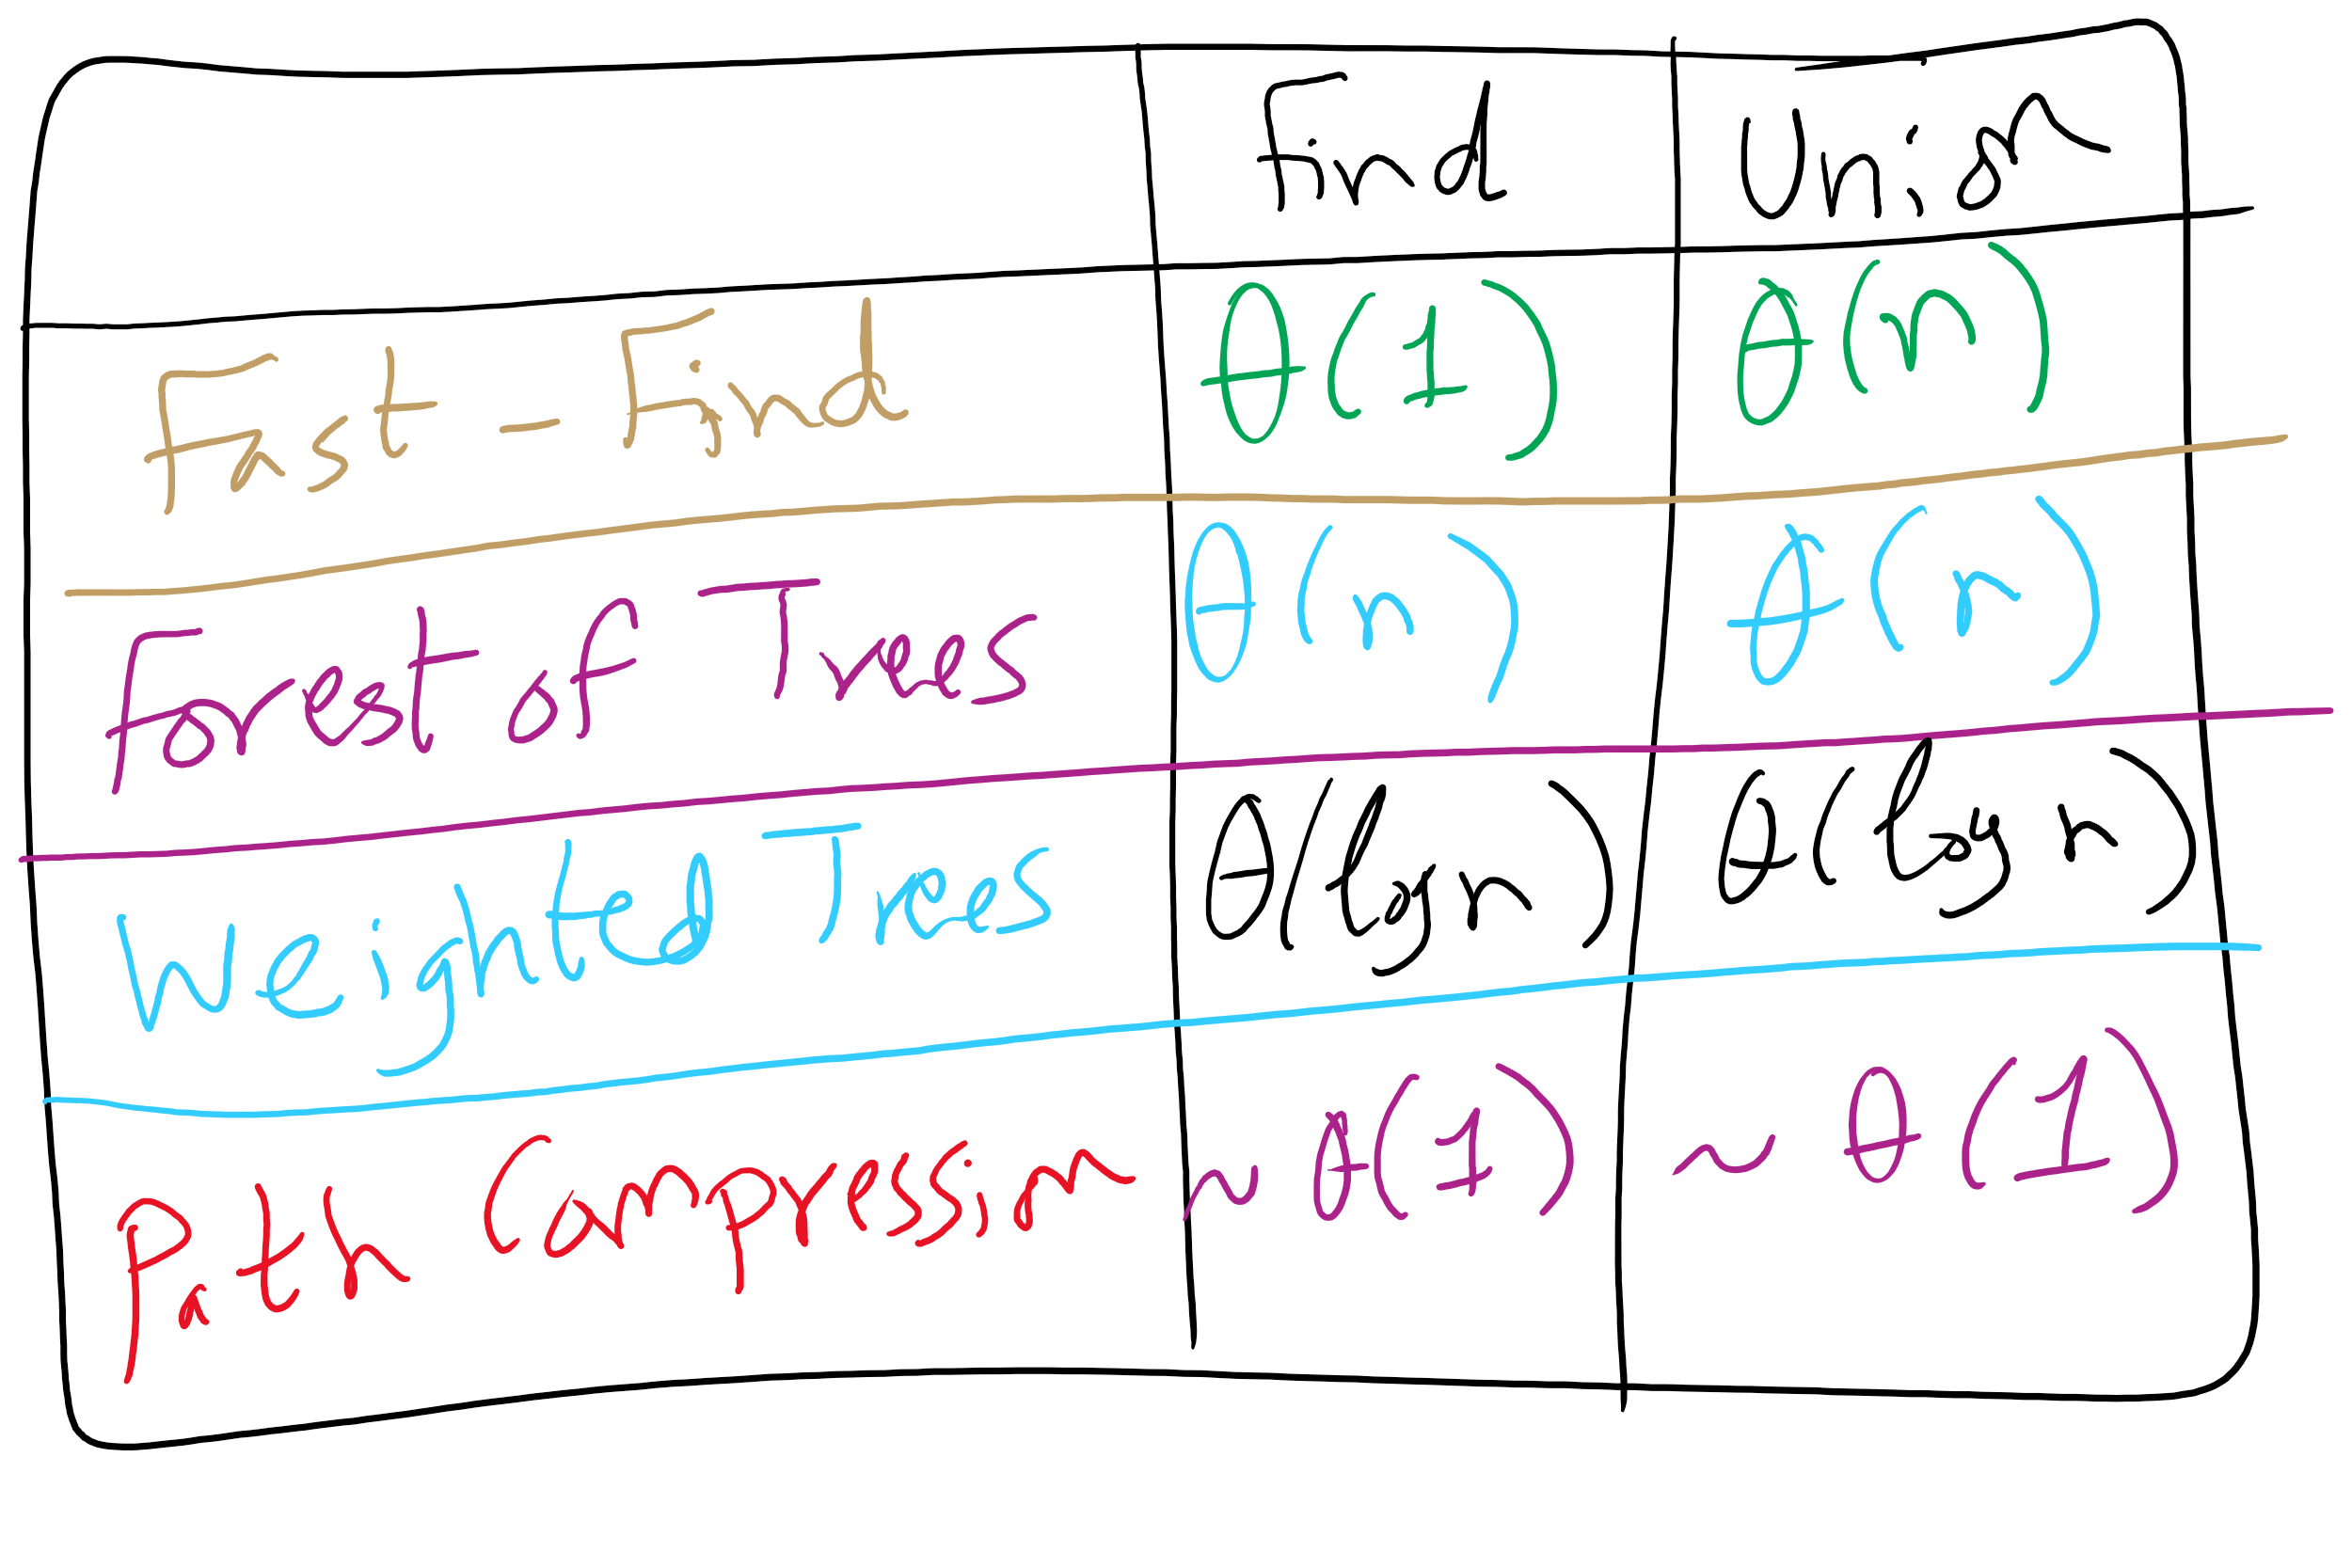
Union-Find Implementations

Slide 47
Kruskal’s runtime
Instead of building up the MST starting from a single vertex, we build it up using edges all over the graph
How do we efficiently implement cycle detection?

Slide 48
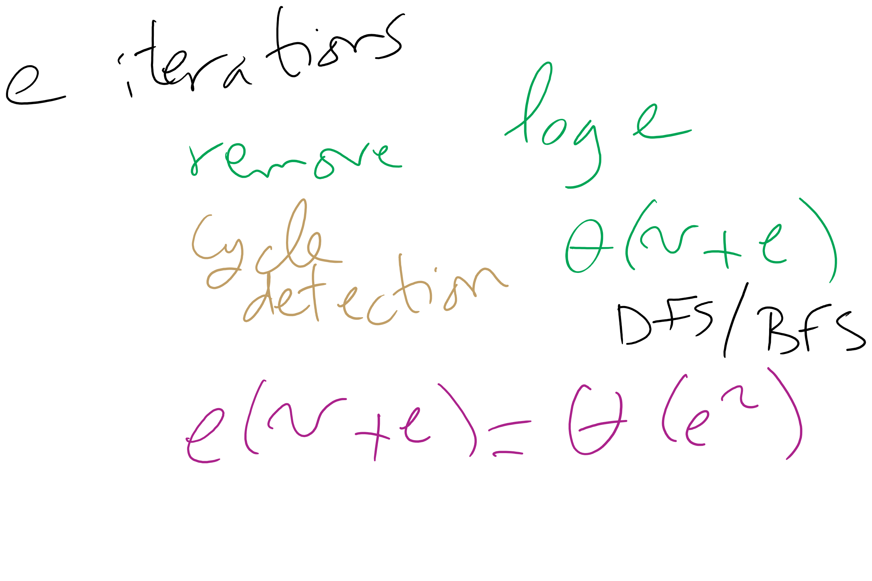
Kruskal’s Runtime: Take 1

Slide 49
Another MST algorithm
Kruskal’s MST:
Insert all edges into a PQ
Grab the min edge from the PQ that does not create a cycle in the MST
Remove it from the PQ and add it to the MST

Slide 50
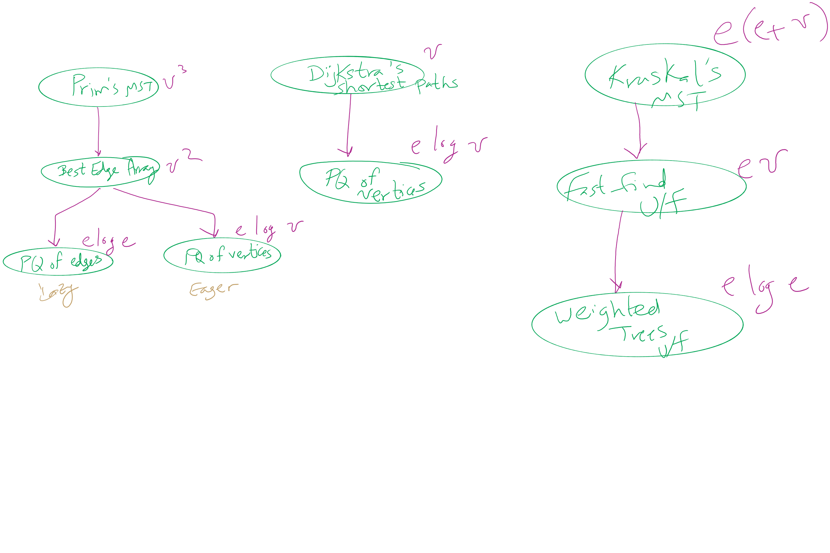
Algorithm Optimizations
2

Slide 51
Please submit your reflections by using the CourseMIRROR App
If you are having a problem with CourseMIRROR, please send an email to coursemirror.development@gmail.com
Notes:
All right!
Upcoming Due Dates at A Glance

